Slide 1
Widening Educational Gaps
Dr. Carmen N. Veloria
Advocacy and Community Relations Advisor
American Student Assistance

Slide 2
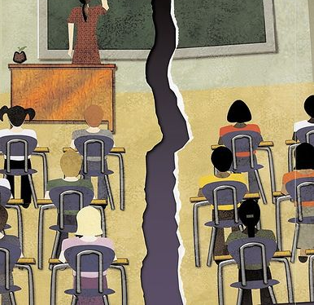
Achievement gap
Opportunity gap
Learning gap
Learning loss
Re-engagement
Higher Education Matriculation
https://www.edglossary.org/achievement-gap/

