Slide 1
COVID-19 and Latinos in MA Dr. Lorna Rivera, Associate Professor & Director Dr. Phil Granberry, Senior Data Analyst Mauricio Gastón Institute for Latino Community Development & Public Policy University of Massachusetts-Boston April 22, 2020

Slide 2
THE MAURICIO GASTÓN INSTITUTE FOR LATINO COMMUNITY DEVELOPMENT & PUBLIC POLICY
The mission of the Gastón Institute is to inform policy makers about issues vital to the state’s growing Latino community and to provide this community with the information and analysis necessary for effective participation in public policy development.
@GastonInstitute Find us on Facebook
+GastonInstitute vimeo.com/GastonInstitute
Notes:
W.

Slide 3
Latinos and other communities of color have disproportionate numbers of COVID-19 infections
Source: Massachusetts Department of Public Health COVID-19 Dashboard - Tuesday, April 21, 2020
Notes:
UNKNOWN IS HUGE. UNDERCOUNTING since February in CA and other places. Recent analysis of death certificates.
Disproportionate infected given their population sizes: Latino share of population is 13%, Black 7%, Asian 3%, and whites 71%

Slide 4
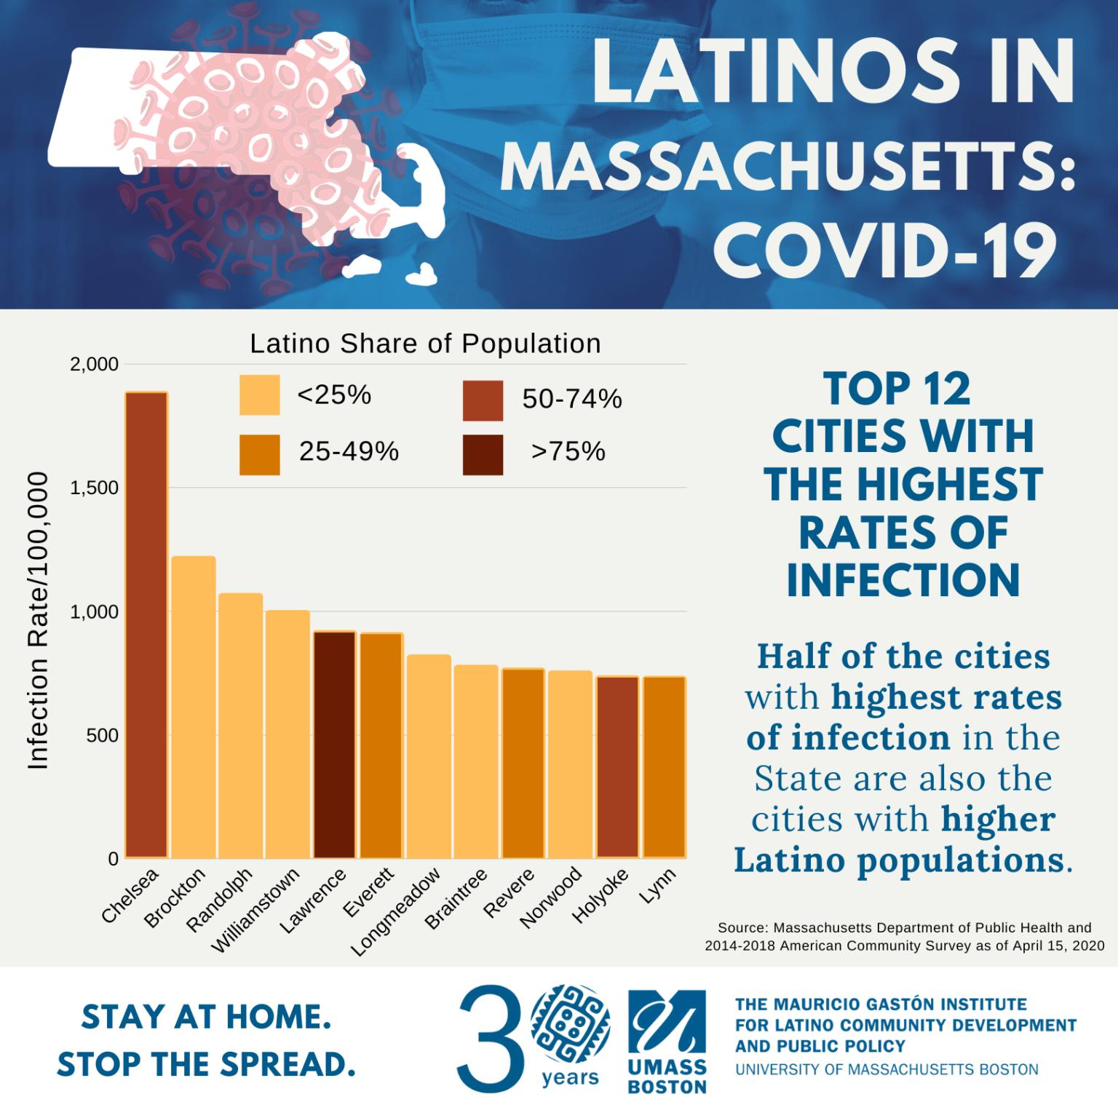

Slide 5
Over half of the state’s Latino population lives in 10 cities and towns in MA.
City or Town | Latino Population | Population Density/ Square Mile | Rank of Density for All Cities and Towns
Boston | 133,893 | 13,597 | 4
Springfield | 69,131 | 4,673 | 24
Lawrence | 64,080 | 10,747 | 7
Worcester | 39,507 | 4,817 | 22
Lynn | 38,828 | 8,087 | 13
Chelsea | 26,645 | 17,139 | 2
Holyoke | 21,054 | 1,768 | 63
Lowell | 20,927 | 7,657 | 14
New Bedford | 19,152 | 4,701 | 23
Revere | 17,526 | 8,656 | 10
Source: 2014-2018 American Community Survey
Notes:
Population density raises the probability of a person’s exposure to the COVID-19 virus. Chelsea, Boston, Lawrence, and Revere are in the top 10 for population density.

Slide 6
What are COVID-19 risk factors for Latinos?
Larger household size increases the possibility of exposure.
Nationally, the average household size for Latinos is 2.86 per household compared to 2.38 per household for non-Latinos.
In MA, 50.2% of Latinos live in households with 4 or more people compared to 37% of non-Latinos living in such households.
Source: 2014-2018 American Community Survey (PUMS)
Notes:
Statewide Latinos in Massachusetts not only live in more densely populated cities and towns. They also live in more crowed households.

Slide 7
Occupational Segregation Source: Gaston Institute Analysis. 2017 American Community Survey
Larger share of total full-time employed Latinos
Notes:
These are the occupations in which at least 90.6% of all MA Latinos are employed. Only 80.3% of non-Latinos are occupied in these areas.
55% of Latinos are occupied in the top 7 occupations. Latinos work in key occupations providing important services during the COVID-19 shutdown, and they fill a disproportionate share of many of these jobs.

Slide 8
10 Cities With the Largest Latino Populations in Massachusetts
Source: 2014-2018 American Community Survey
Notes:
There have been some dramatic population changes in some MA cities.

Slide 9
Latino Student Enrollment by District with Largest Latino Populations (SY2019-2020)
Source: Massachusetts Department of Elementary and Secondary Education

Slide 10
ELs’ Race and Ethnic Distribution
English Learners in Massachusetts represent 10.5% of all students. Latinx students account for almost 59% of the ELs in the state.
English Learners in Gateway cities represent 20.4% of all students. Latinx students account for about 66% of all ELs in gateway cities .
Source: Massachusetts Department of Elementary and Secondary Education.

Slide 11
Latino HS students
Of the 296,133 HS students in MA, 56,443 (19.1%) are Latino/Hispanic
Of those 56,443 Latinos:
23.5% were English Learners
20.3% were students with disabilities
55.7% were economically disadvantaged
Graduation and post secondary education outcomes based on a cohort entering high school in Sept 2011. Enrollment and persistence at any college. Gaps exist all along this pipeline towards completion of post secondary education
Source: Massachusetts Department of Elementary & Secondary Education. AY2018
Notes:
Will COVID-19 crisis make this worse? Already 31% of nine graders persist to graduation…

